Slide 1


Slide 2
AWS Glue provides a serverless solution that simplifies the entire process of discovering, preparing, and combining data for application development, machine learning, and analytics.
To adequately define what AWS Glue is, you’ll first need to understand how data integration works.
In essence, you can think of data integration as the process of setting up and putting together data for analytics, application development, and machine learning.
It’s made up of multiple procedures – such as identifying and generating data from different sources, which is then followed by enriching, cleaning, normalizing, and merging data. In the end, the data is loaded and organized in data warehouses, databases, and data lakes.
AWS Glue facilitates all the data integration procedures so you can quickly put your merged data to good use. That means you get to analyze and leverage the data in minutes, instead of waiting around forever.
Considering these capabilities, AWS Glue is technically described as a fully-managed ETL (Extract, Transform, and Load) data integration solution.
Amazon even goes on to explain that the whole system is designed to provide an easy and cheap way to not only categorize your data, but also clean, enrich, and transfer it efficiently between different data streams and data stores.
It doesn’t run across one front, though. Rather, AWS Glue comes as a multi-faceted system that powers data integration through three core components.

Slide 3
AWS Glue is a serverless, fully managed data integration service that makes it easy to discover, prepare, and combine data for analytics, machine learning (ML), and application development. You simply point AWS Glue to your data stored on AWS, and AWS Glue discovers your data and stores the associated metadata (such as table definition and schema) in the AWS Glue Data Catalog.
Once cataloged, your data is immediately searchable, queryable, and available for extract, transform, load (ETL). One of the most difficult tasks in building a data pipeline is to integrate data from various sources which could be structured, semi-structured, or even un-structured; and that is where AWS Glue shines. AWS Glue provides both visual and code-based interfaces to help build ETL jobs and data pipelines faster.
The AWS Glue product family includes several services that cater to varying user personas and allows them to catalog, transform, clean, enrich, and deliver data in a consistent and reliable way.
The AWS Glue product family consists of AWS Glue for cataloging and ETL transformation, and AWS Glue DataBrew for self-service, no-code data preparation.

Slide 4
Why Use AWS Glue?

Slide 5
Serverless: There is no need to provision or manage servers, which reduces operational overhead.
Automatic code generation: AWS Glue can automatically generate Python or Scala code for ETL jobs.
Built-in job scheduling and monitoring: This capability makes scheduling and monitoring ETL jobs easy.
Data discovery and cataloging: AWS Glue crawlers can automatically discover, catalog, and prepare data for analysis.
Integration with other AWS services: Seamlessly works with services like Amazon S3, Amazon RDS, and Amazon Redshift.
Cost-effective: You only pay for the resources consumed while ETL jobs run.

Slide 6
AWS Glue features

Slide 7
Run ETL jobs as newly collected data arrives – AWS Glue, for instance, lets you automatically run ETL jobs when new data arrives in your Amazon Simple Storage Service (S3) buckets.
Data Catalog – Use it to rapidly browse and search multiple AWS datasets without needing to move the data. The cataloged data is immediately searchable and queryable with Amazon Athena, Amazon Redshift Spectrum, and Amazon EMR.
AWS Glue Studio -It supports no-code ETL jobs. AWS Glue Studio enables you to visually build, run, and monitor AWS Glue ETL jobs. Your ETL jobs can move and transform data with a drag-and-drop editor. AWS Glue auto-generates the code.
Multi-method support – Supports a variety of data processing approaches and workloads, such as ETL, ELT, batch, and streaming. You can also use your favorite method, from drag and drop or writing code to connecting with your notebook.
AWS Glue Data Quality – Creates, manages, and monitors data quality rules automatically. This ensures high-quality data throughout your data lakes and pipelines.

Slide 8
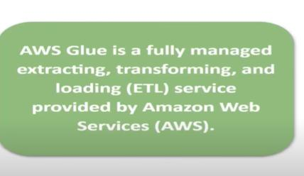

Slide 9


Slide 10
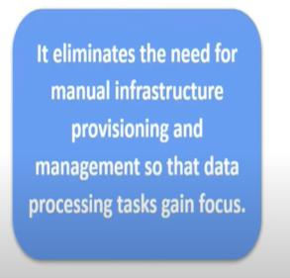

Slide 11


Slide 12
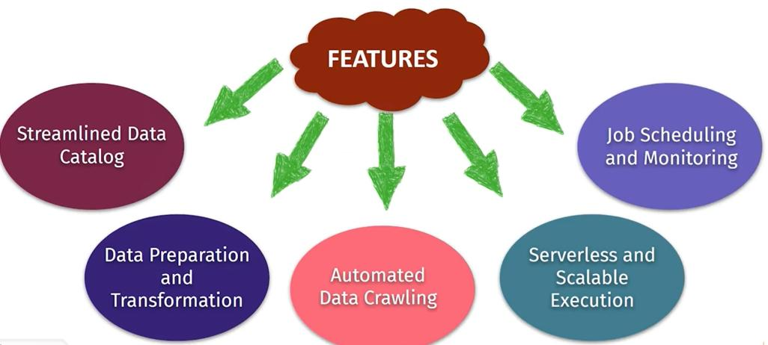

Slide 13
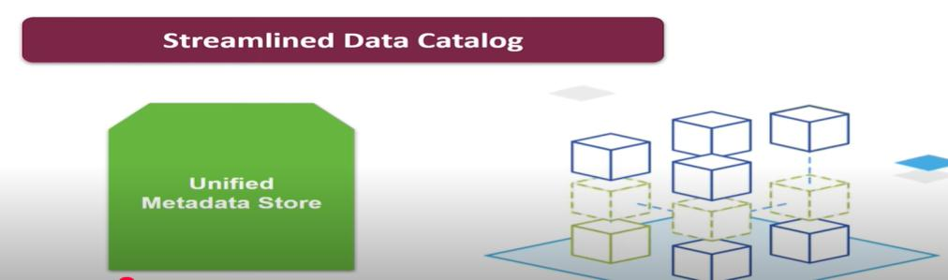




Slide 14
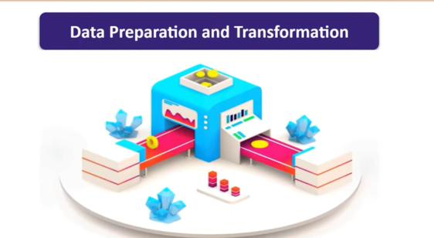

Slide 15
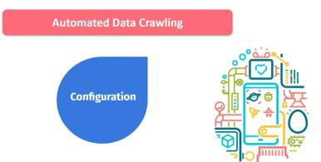
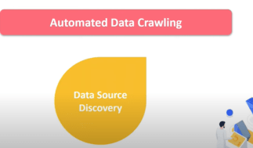
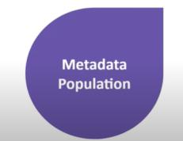

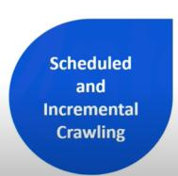





Slide 16
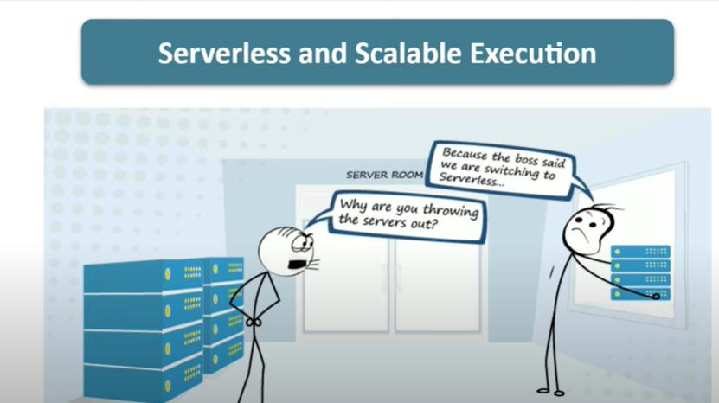

Slide 17
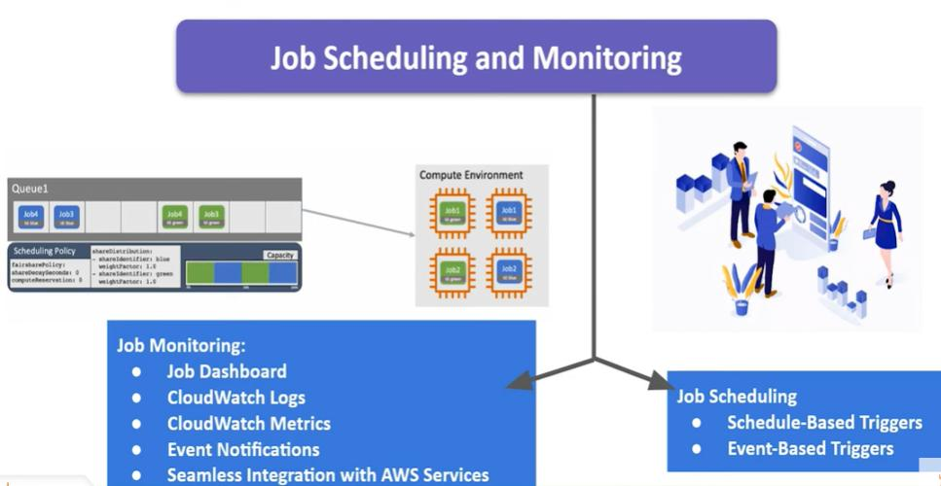

Slide 18


Slide 19
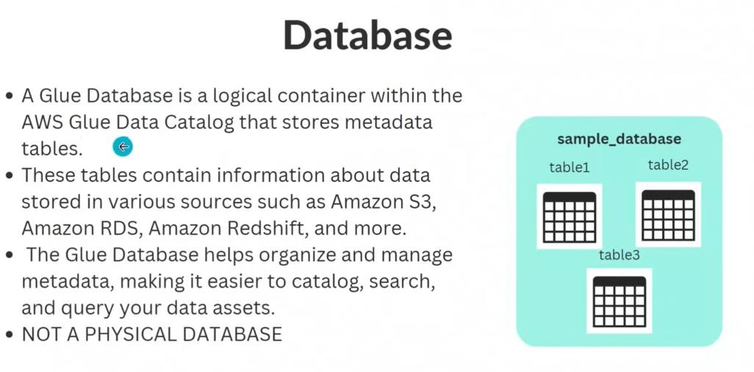

Slide 20
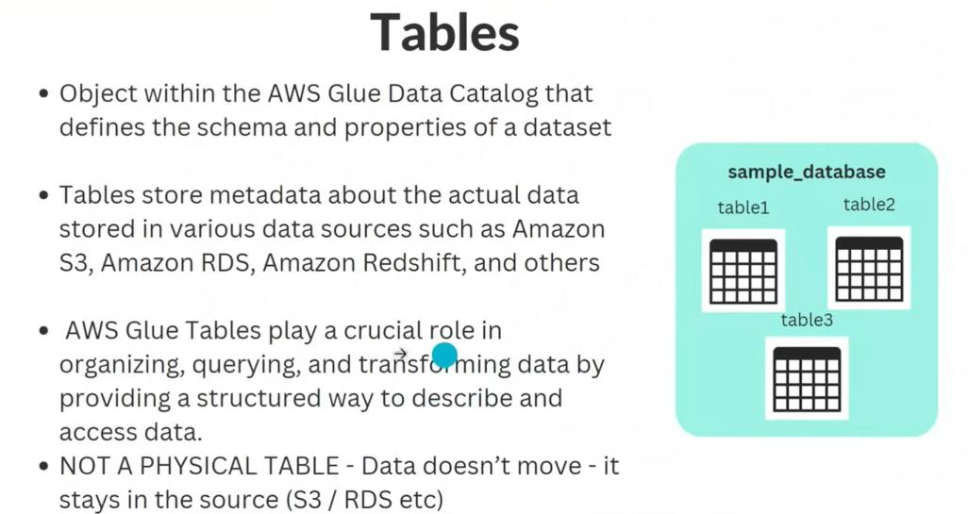

Slide 21
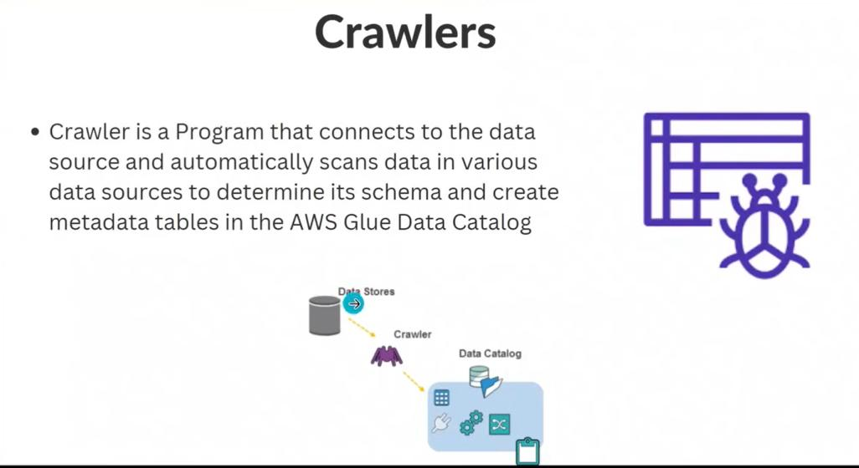

Slide 22
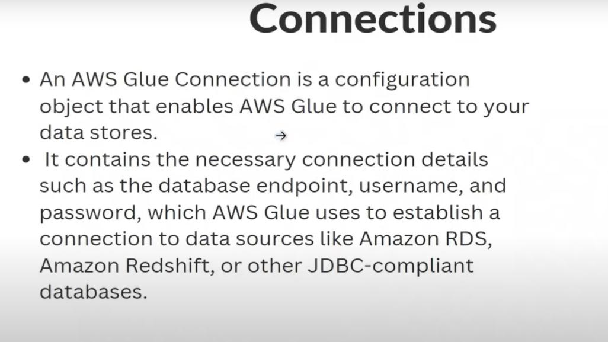

Slide 23
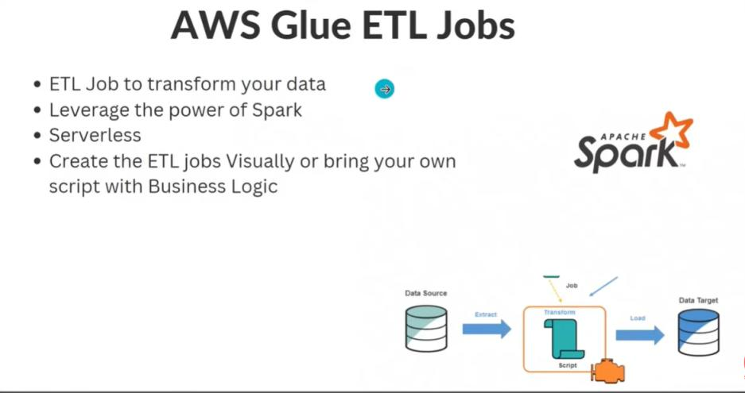

Slide 24
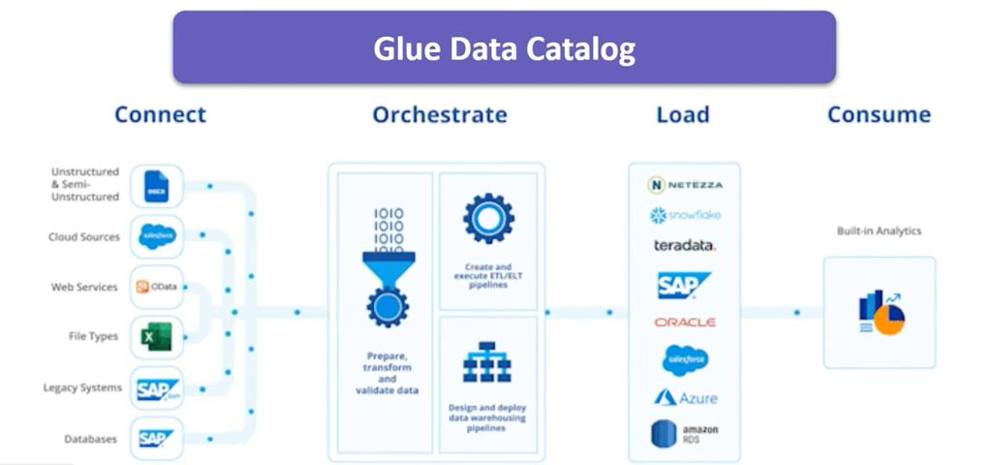

Slide 25
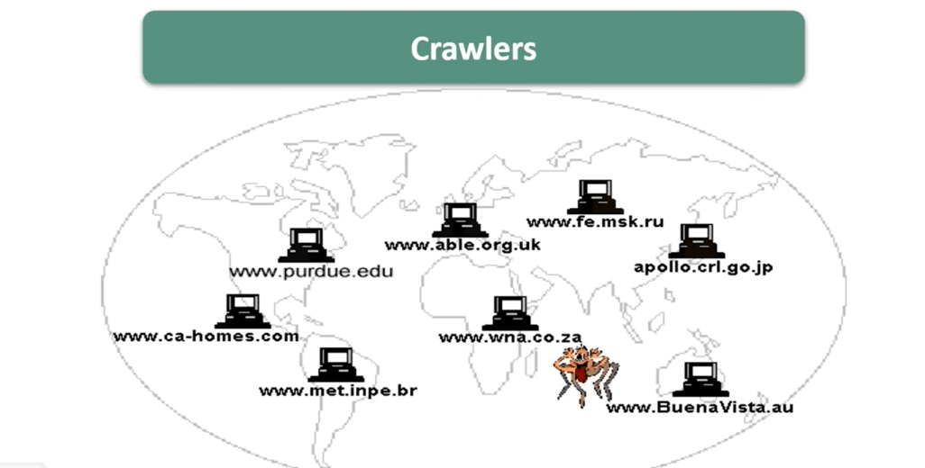

Slide 26
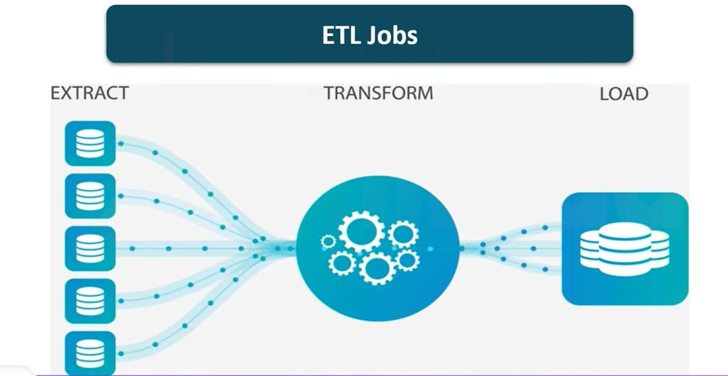

Slide 27
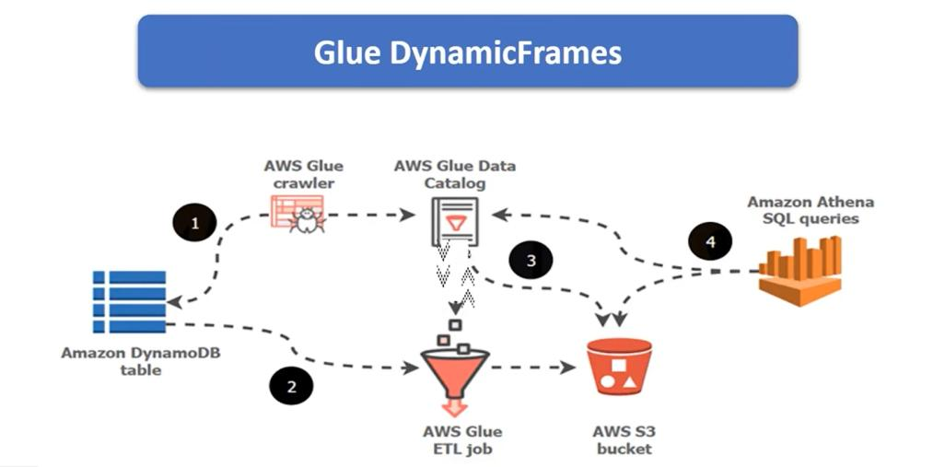

Slide 28
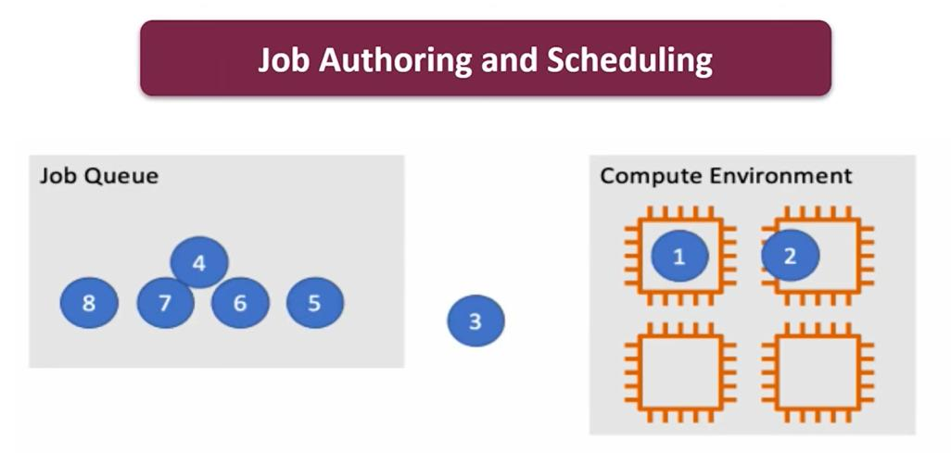

Slide 29
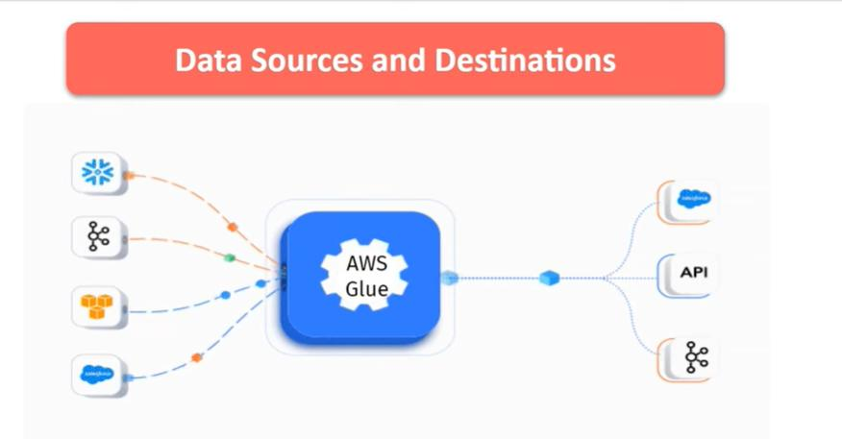

Slide 30
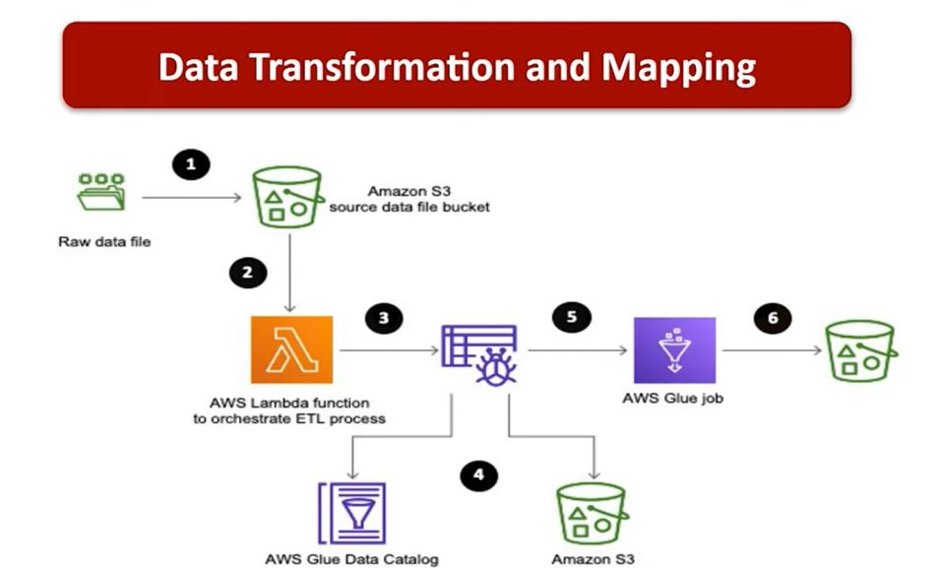

Slide 31


Slide 32
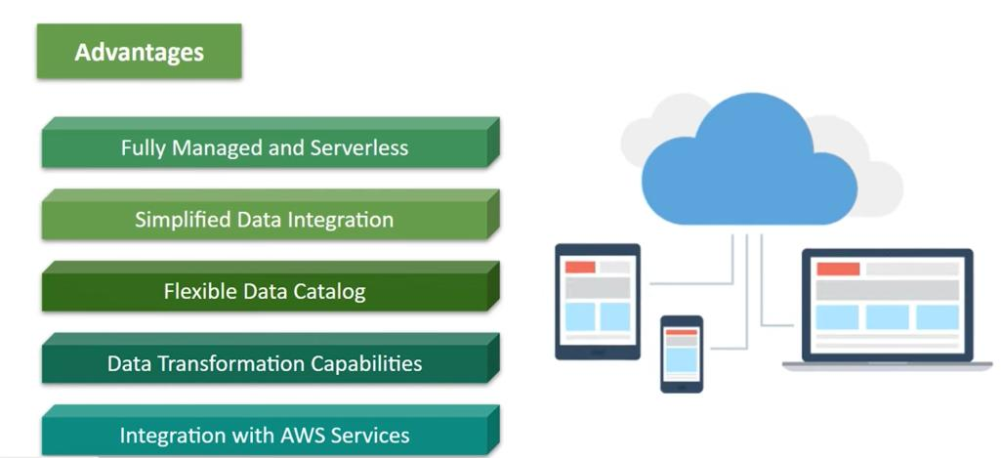

Slide 33
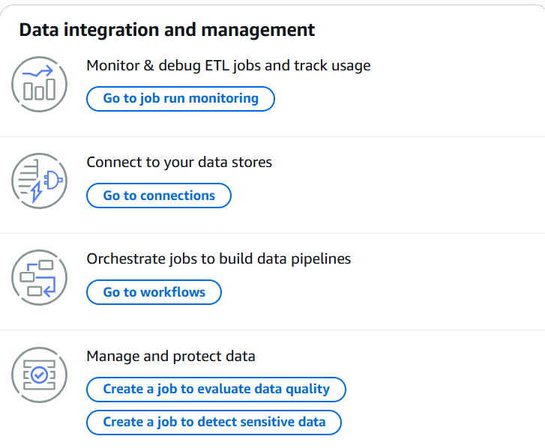

Slide 34
Challenges in building a data pipeline
Building a well-architected and high performing data pipeline requires upfront planning and design of multiple aspects of data storage, including data structure, schema design, schema change handling, storage optimization, and quick scaling to meet the unexpected increase in application data volume and so on. This often requires an ETL mechanism that is designed to orchestrate the transformation of data in multiple steps. You also need to ensure that the ingested data is validated for the data quality or data loss, and monitored for job failures and data exceptions that are not handled with ETL job design.
Here are some common challenges a data engineer typically faces:
Increase in data volume for processing
Change of structure of source data
Poor data quality
Poor data integrity in source data
Duplicate data
Timeliness of source data files
Lack of available developer interface for testing

Slide 35
What are the components of AWS Glue?

Slide 36
The console – The AWS Glue console is where you define and orchestrate your workflow. There are several API operations you can call from here to perform tasks, such as defining AWS Glue objects, editing transformation scripts, and defining events or job schedules for job triggers.
AWS Glue Data Catalog – This is basically a central repository for your metadata, built to hold information in metadata tables — with each table pointing to a single data store. In other words, it acts as an index to your data schema, location, and runtime metrics, which are then used to identify the targets and sources of your ETL (Extract, Transform, Load) jobs.
Job Scheduling System – The job scheduling system, on the other hand, is intended to help you automate and chain your ETL pipelines. It comes in the form of a flexible scheduler that’s capable of setting up event-based triggers and job execution schedules.
Script – The AWS Glue service generates a script to transform your data. Alternatively, you can upload your script via the AWS Glue API or console. Scripts extract data from your data source, transform it, and load it into your data target. In AWS Glue, the scripts run in an Apache Spark environment.
Connection – This refers to a Data Catalog object that comprises properties for connecting to a given data store.
Data store – This is where your data is stored persistently, such as relational databases and Amazon S3.
Data source – This refers to a data store that serves as input to a transform or process.
Data target – This is the data store that a process writes to.
Transform – Refers to the code logic used to change the format of your data.
ETL Engine – AWS Glue’s ETL engine is the one component that handles ETL code generation. It automatically provides this in Python or Scala, and then proceeds to even give you the option of customizing the code.
Crawler and Classifier – A crawler helps retrieve data from the source through integrated or custom classifiers. This AWS Glue component creates or uses metadata tables pre-defined in the data catalog.
Job – This is the business logic that performs an ETL task in AWS Glue. Internally, Apache Spark with Python or Scala writes the business logic.
Trigger – This starts ETL job execution at a specific time or on-demand.
Development endpoint – This creates a development environment in which your ETL job script can be developed, tested, and debugged.
Database – It creates or accesses source and target databases.
Table – You can create one or more tables in the database for use by the source and target.
Notebook server – An online environment for running PySpark statements, a Python dialect for ETL programming. With AWS Glue extensions, you can run PySpark statements on a notebook server.

Slide 37
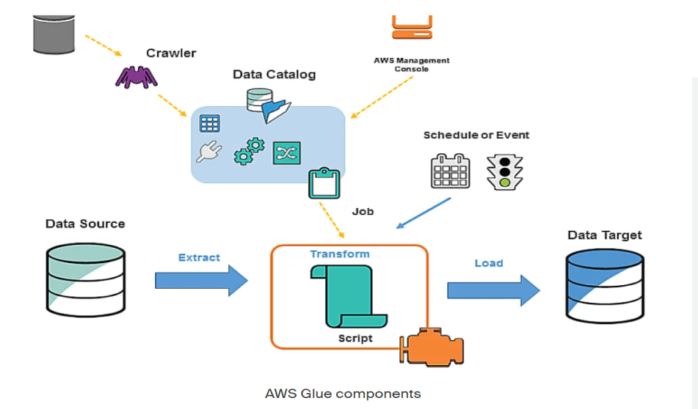

Slide 38
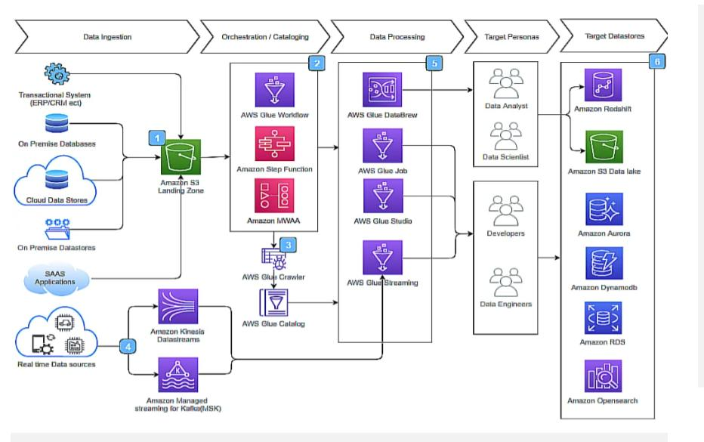

Slide 39
What is AWS Glue Studio?
AWS Glue Studio is a new graphical interface that makes it easy to create, run, and monitor ETL jobs in AWS Glue. You can visually compose data transformation workflows, and seamlessly run them on the AWS Glue Apache Spark-based serverless ETL engine. You can inspect the schema and data results in each step of the job. Use AWS Glue Studio for a simple visual interface to create ETL workflows for data cleaning and transformation, and run them on AWS Glue. AWS Glue Studio makes it easy for ETL developers to create repeatable processes to move and transform large-scale, semi-structured datasets, and load them into data lakes and data warehouses. It provides a boxes-and-arrows style visual interface for developing and managing AWS Glue ETL workflows that you can optionally customize with code. AWS Glue Studio combines the ease of use of traditional ETL tools, and the power and flexibility of the big AWS Glue data processing engine.
AWS Glue Studio provides multiple ways to customize your ETL scripts, including adding nodes that represent code snippets in the visual editor.

Slide 40
Transform data with AWS Glue managed transforms
AWS Glue Studio provides two types of transforms:
AWS Glue-native transforms - available to all users and are managed by AWS Glue.
Custom visual transforms - allows you to upload your own transforms to use in AWS Glue Studio

Slide 41
Reference architecture with the AWS Glue
While working with customers, AWS encountered several different architecture patterns in which the customer used services from the AWS Glue product family to build their data pipelines. Following are some of the common architecture patterns based on user personas.
The steps the data takes in the architecture shown in the preceding figure are as follows:
Data ingestion — Data is extracted from various data sources, including transactional data sources such as customer relationship management/enterprise resource planning (CRM/ERP), on-premises databases such as Oracle and SQL Server, on-premises data stores, Sales as a Service (SaaS) applications such as Salesforce, SAP Concur, and so on for further processing.
Job orchestration — As a new file uploaded into an S3 landing zone or a time-based schedule is triggered, an orchestration workflow is trigger using AWS Step Functions, Amazon Managed Workflow for Apache Airflow (MWAA), or AWS Glue workflow. Depending on the business requirement, workflows are also triggered using a predefined and time-based schedule to process file at certain intervals.
Data cataloging (optional) — The job orchestrator triggers an AWS Glue workflow to crawl the location of the file and build or update AWS Glue Data Catalog. The AWS Glue Data Catalog contains references to data that is used as sources and targets of your ETL jobs in AWS Glue.
Data streaming — To process streaming data in near real time, customers commonly ingest the data into Amazon Kinesis Data Streams or Amazon MSK. This data can then be consumed by an AWS Glue streaming ETL application for further processing.
Data processing — Processes and transforms data and data format, data quality and integrity checks, deduplications, transformation, and so on.
Data loading — Loads data after processing and transforming to data targets, including data lakes such as S3 locations, relational targets such as Amazon Redshift, Amazon RDS, Amazon Aurora, Amazon OpenSearch Service, or Amazon DynamoDB.

Slide 42
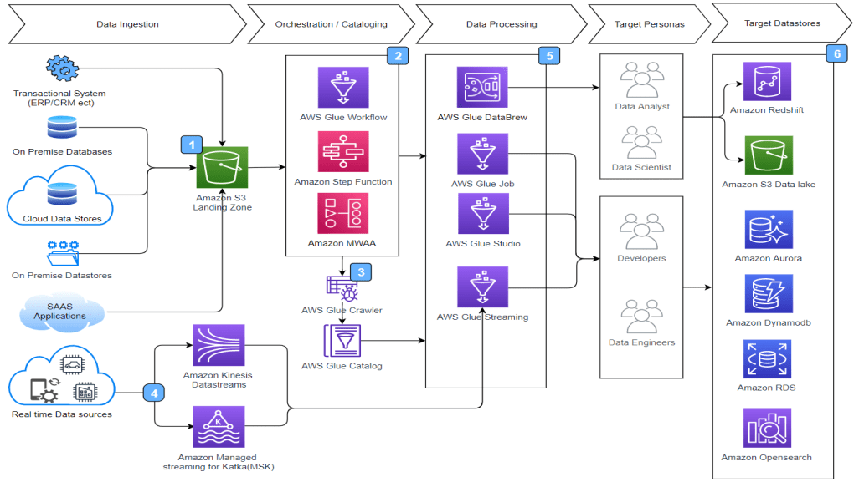

Slide 43
Building a data lake
Data ingestion — Data is extracted from various data sources like transactional data sources such as CRM/ERP, on-premises databases such as Oracle and SQL Servers, on-premises data stores, SaaS applications such as Salesforce, SAP Concur, and so on into a landing zone in S3 for further processing. In this step commonly, Amazon AppFlow is used for SaaS applications, AWS Database Migration Service (AWS DMS) is used for ingesting data from on-premises and cloud databases such as AWS Data Exchange and is used for integrating third-party data into the data lake.
Job orchestration — As a new file is uploaded into an S3 landing zone, a Lambda function or event driven AWS Glue workflow triggers orchestration workflow using AWS Step Functions, MWAA, or AWS Glue workflow. Depending on the business requirements, workflows are also triggered using a predefined and time-based schedule to process file at certain intervals.
Data cataloging (optional) — The job orchestrator triggers an AWS Glue workflow to crawl the location of the file and build or update the AWS Glue Data Catalog. The AWS Glue Data Catalog contains references to data that is used as sources and targets for your ETL jobs in AWS Glue.
Data processing — The data is processed and transforms data that is transforming data and improving data quality, performing integrity checks, and so on.
Data loading — In this step, the processed and transformed data is loaded into data into an S3-based curated zone with appropriate partitions and data format, which is used as a data lake layer.
Unified governance — AWS Lake Formation is commonly used for implementation of unified governance on a data lake. Additionally, if you are looking for transactional capability and small file compaction with AWS Lake Formation, governed tables can also be considered.
Amazon QuickSight — Amazon QuickSight allows everyone in your organization to understand your data by asking questions in their natural language, exploring through interactive dashboards, or automatically looking for patterns and outliers powered by ML.
Amazon Athena — Amazon Athena provides capability for ad hoc querying capability on the data stored in the data lake.
Amazon SageMaker AI — Amazon SageMaker AI and AWS AI services can be used to build, train, and deploy ML models, and add intelligence to your applications.
Logging, monitoring and notification — Amazon CloudWatch can be used for monitoring, Amazon Simple Notification Service (Amazon SNS) can be used for notification, and AWS CloudTrail can be used for logging of events.

Slide 44
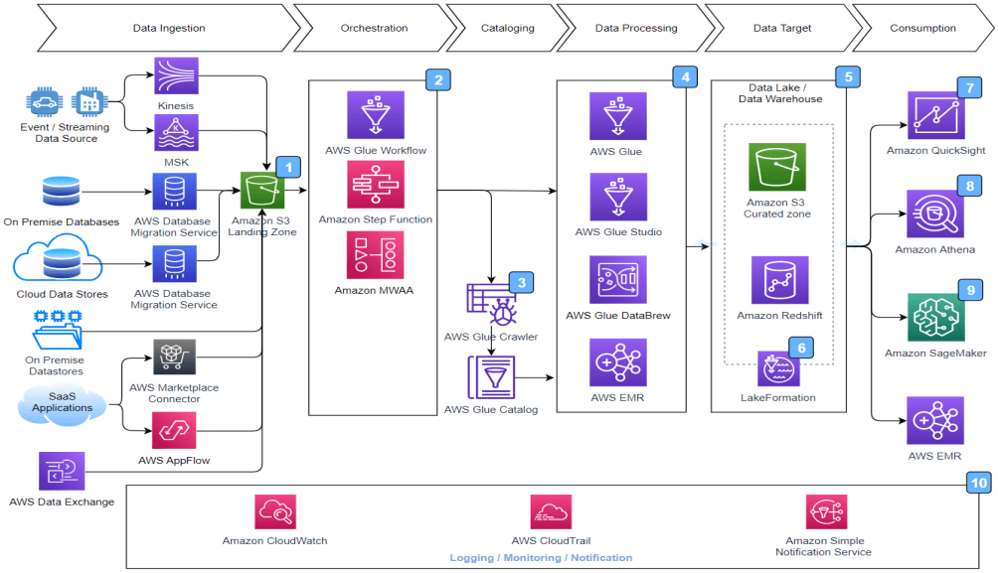

Slide 45
Building a streaming data pipeline
Data Source — In the previous architecture, there are multiple data sources. Near real-time data is generated through streaming data sources such as IoT devices, log and diagnostic data from application servers, and change data capture (CDC) from transactional data stores.
Data steaming — Messages and events are streamed into streaming services such as Amazon Kinesis Data Streams or Amazon MSK.
Stream data processing — In this step, you can create streaming ETL jobs that run continuously and consume data from streaming sources such as Amazon Kinesis Data Streams and Amazon MSK. The jobs cleanse and transform the data.
Stream data loading — The processed data is typically loaded into S3 data lakes or joint database connectivity (JDBC) data stores such as Amazon Redshift or NoSQL data sources such as Amazon DynamoDB or Amazon OpenSearch Service. After the data is loaded, the data can be consumed using services such as Amazon QuickSight, Amazon Athena, Amazon SageMaker AI, Amazon Managed Grafana, and so on.
Amazon QuickSight: — Amazon QuickSight allows everyone in your organization to understand your data by asking questions in their native language, exploring through interactive dashboards, or automatically looking for patterns and outliers powered by ML.
Amazon Athena — Amazon Athena provides capability for ad hoc querying capability on the data stored in the data lake.
Amazon SageMaker AI — Amazon SageMaker AI and AWS AI services can be used to build, train, and deploy ML models, and add intelligence to your applications.
Amazon Managed Grafana — Amazon Managed Grafana is an open-source analytics platform that can be used to query, visualize, alert on, and understand metrics, no matter where they are stored.
Logging, monitoring, and notification — Amazon CloudWatch can be used for monitoring, Amazon SNS can be used for notification, and AWS CloudTrail can be used for event logging.

Slide 46
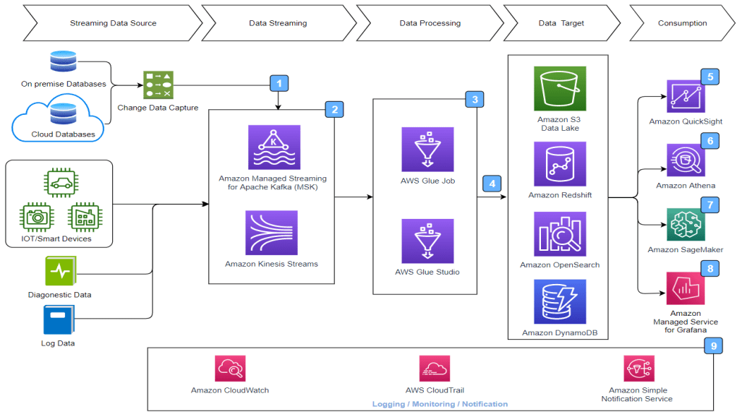

Slide 47
AWS Glue managed data transform nodes
ChangeSchema: Map data property keys in the data source to data property keys in the data target. You can rename keys, modify the data types for keys, and choose which keys to drop from the dataset.
SelectFields: Choose the data property keys that you want to keep.
DropFields: Choose the data property keys that you want to drop.
RenameField: Rename a single data property key.
Spigot: Write samples of the data to an Amazon S3 bucket.
Join: Join two datasets into one dataset using a comparison phrase on the specified data property keys. You can use inner, outer, left, right, left semi, and left anti joins.
Union: Combine rows from more than one data source that have the same schema.
SplitFields: Split data property keys into two DynamicFrames. Output is a collection of DynamicFrames: one with selected data property keys, and one with the remaining data property keys.
SelectFromCollection: Choose one DynamicFrame from a collection of DynamicFrames. The output is the selected DynamicFrame.
FillMissingValues: Locate records in the dataset that have missing values and add a new field with a suggested value that is determined by imputation
Filter: Split a dataset into two, based on a filter condition.
Drop Null Fields: Removes columns from the dataset if all values in the column are ‘null’.

Slide 48
Drop Duplicates: Removes rows from your data source by choosing to match entire rows or specify keys.
SQL: Enter SparkSQL code into a text entry field to use a SQL query to transform the data. The output is a single DynamicFrame.
Aggregate: Performs a calculation (such as average, sum, min, max) on selected fields and rows, and creates a new field with the newly calculated value(s).
Flatten: Extract fields inside structs into top level fields.
UUID: Add a column with a Universally Unique Identifier for each row.
Identifier: Add a column with a numeric identifier for each row.
To timestamp: Convert a column to timestamp type.
Format timestamp: Convert a timestamp column to a formatted string.

Slide 49
Conditional Router transform: Apply multiple conditions to incoming data. Each row of the incoming data is evaluated by a group filter condition and processed into its corresponding group.
Concatenate Columns transform: Build a new string column using the values of other columns with an optional spacer.
Split String transform: Break up a string into an array of tokens using a regular expression to define how the split is done.
Array To Columns transform: Extract some or all the elements of a column of type array into new columns.
Add Current Timestamp transform: Mark the rows with the time on which the data was processed. This is useful for auditing purposes or to track latency in the data pipeline.
Pivot Rows to Columns transform: Aggregate a numeric column by rotating unique values on selected columns which become new columns. If multiple columns are selected, the values are concatenated to name the new columns.
Unpivot Columns To Rows transform: Convert columns into values of new columns generating a row for each unique value.
Autobalance Processing transform: Redistribute the data better among the workers. This is useful where the data is unbalanced or as it comes from the source doesn’t allow enough parallel processing on it.

Slide 50
Derived Column transform: Define a new column based on a math formula or SQL expression in which you can use other columns in the data, as well as constants and literals.
Lookup transform: Add columns from a defined catalog table when the keys match the defined lookup columns in the data.
Explode Array or Map Into Rows transform: Extract values from a nested structure into individual rows that are easier to manipulate.
Record matching transform: Invoke an existing Record Matching machine learning data classification transform.
Remove null rows transform: Remove from the dataset rows that have all columns as null, or empty.
Parse JSON column transform: Parse a string column containing JSON data and convert it to a struct or an array column, depending if the JSON is an object or an array, respectively.
Extract JSON path transform: Extract new columns from a JSON string column.
Extract string fragments from a regular expression: Extract string fragments using a regular expression and create new column out of it, or multiple columns if using regex groups.
Custom transform: Enter code into a text entry field to use custom transforms. The output is a collection of DynamicFrames.

Slide 51
AWS Glue PySpark transforms reference
GlueTransform base class
ApplyMapping class
DropFields class
DropNullFields class
ErrorsAsDynamicFrame class
EvaluateDataQuality class
FillMissingValues class
Filter class
FindIncrementalMatches class
FindMatches class
FlatMap class
Join class

Slide 52
Map class
MapToCollection class
mergeDynamicFrame
Relationalize class
RenameField class
ResolveChoice class
SelectFields class
SelectFromCollection class
Simplify_ddb_json class
Spigot class
SplitFields class
SplitRows class
Unbox class
UnnestFrame class

Slide 53
DI transforms:
FlagDuplicatesInColumn class
FormatPhoneNumber class
FormatCase class
FillWithMode class
FlagDuplicateRows class
RemoveDuplicates class
MonthName class
IsEven class
CryptographicHash class
Decrypt class
Encrypt class
IntToIp class
IpToInt class

Slide 54
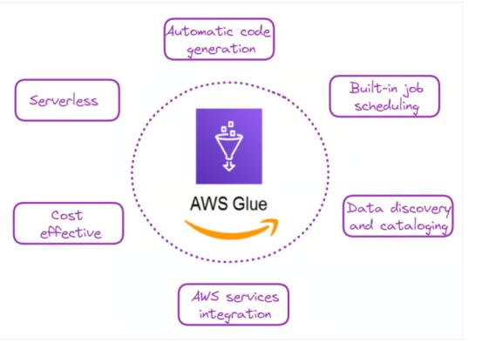

Slide 55
AWS Glue: A Step-by-Step Guide

Slide 56
1. AWS account setup
For those new to AWS, the first step would be to create an account and then log in to the management console.
Go to AWS and sign up.
Once you have an account, log in to the AWS Management Console.

Slide 57
3. S3 bucket setup
The input data for this example was created for illustration purposes and can be found in the author’s GitHub repository:
athletes.csv: Contains information about athletes, including their ID, name, country, sport, and age.
events.csv: Lists various events, including event ID, sport, event name, date, and venue.
medals.csv: Records medal information, linking events and athletes to the medals they won.
Now, we can set up our S3 bucket as follows:
Go to the S3 service in the AWS Management Console.
Click "Create bucket" and give it a unique name (e.g., "my-glue-csv-etl-bucket").
Leave the bucket default settings for simplicity’s sake and create the bucket.
Create two folders inside your bucket: "input" and "output."

Slide 58
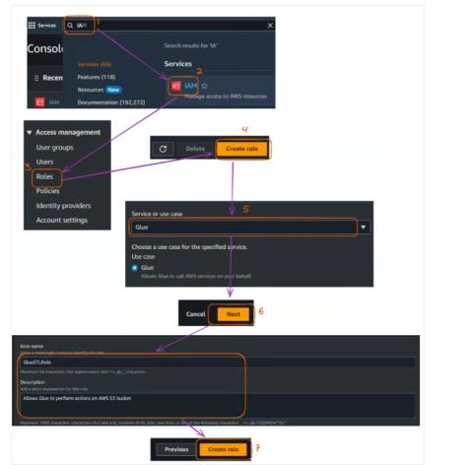
2. IAM role creation
AWS Identity and Access Management (IAM) allows users to securely manage access to AWS services and resources.
We need to create an IAM role to allow Glue to access relevant services. In our case, the main service we are accessing is S3,
which hosts our CSV files.
The AWS Storage Tutorial is a great way for new AWS users to learn more about systems like S3.
The main steps to creating that IAM role are described below, starting from the Management Console:
Navigate to the IAM service.
Click "Roles" in the left sidebar, then click "Create role".
Under "Choose a use case," select "Glue" and click "Next: Permissions."
Search for and select the following policies:
AWSGlueServiceRole
AmazonS3FullAccess (Note: In a production environment, you should create a more restrictive policy).
Name your role (e.g., "GlueETLRole"), and eventually give a description, but that is not mandatory. Finally, click "Create role".

Slide 59
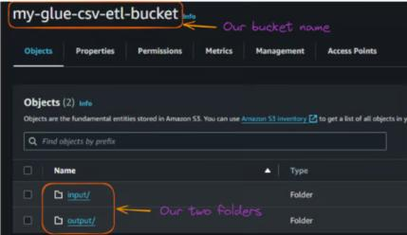
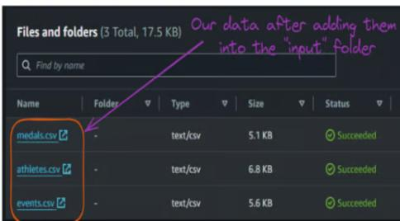
After creating the two folders, the content of your bucket should look like this:
Now, we can upload these input CSV files to the "input" folder.

Slide 60
4. Creating a Glue crawler
A Glue crawler is used to discover and catalog our data automatically. This section explains how to create a crawler that scans all the input CSV files.
The main steps are explained below:
Go to the AWS Glue service in the AWS Management Console.
In the left sidebar, under "Data catalog," click on "Crawlers."
Click "Create crawler".
Name your crawler (e.g., "CSV-to-Parquet-Crawler") and leave the description field empty, then click "Next."
We need to specify “S3” as the data source, which is done by choosing "Add data source " as the crawler source type and clicking "Next."

Slide 61
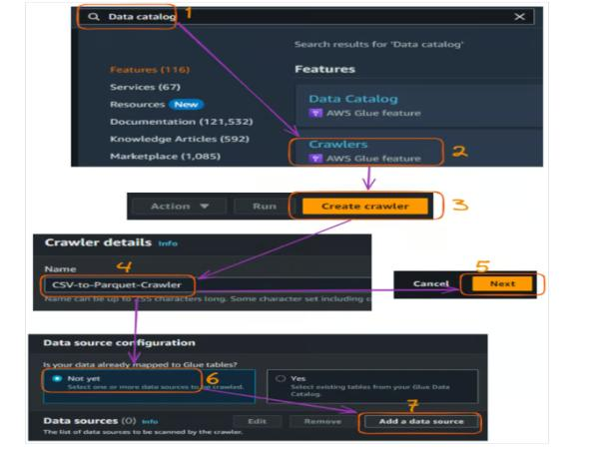

Slide 62
Choose "S3" as the data store and specify your S3 bucket path, which you can do by selecting “Browse S3.” Then click "Next."
Select “Crawl all sub-folders”
Select “Add an S3 data source”, then click "Next."
Before moving further, check the “S3” data type, then “Next.”

Slide 63
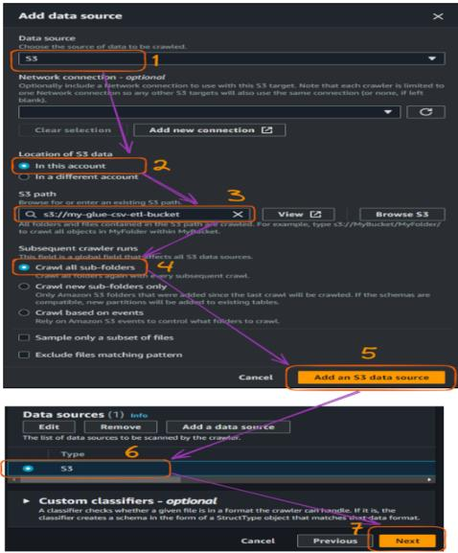

Slide 64
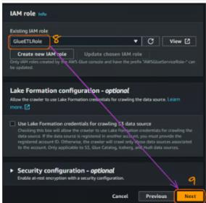
Once we have connected the S3 bucket, we need to connect the IAM role that was previously created to allow Glue to access S3 buckets. The name of our role is “GlueETLRole.”
Choose the role name from the “Existing IAM role” field.
Click “Next.”

Slide 65
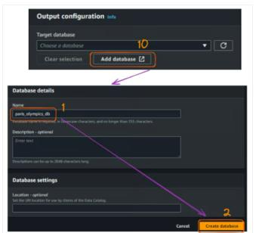
The next step is to create a database. The “paris_olympics_db” database we will create serves as a central repository in the AWS Glue Data Catalog to store and organize metadata about our CSV files.
The catalog will enable efficient data discovery and simplifying our ETL process for combining and converting the athletes, events, and medals data into Parquet format.
At this moment, we do not have any database yet, and the creation steps are illustrated below:
Select “Add database,” which will open a new window for creating our database. Give it the name “paris_olympics_db” while leaving everything else as default, and click “Create database.”

Slide 66
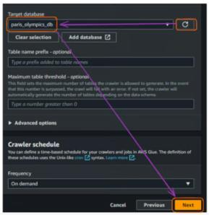
From the original tab where we connect a database, refresh the “Target database” section and choose the newly created database. Then click “Next.”

Slide 67
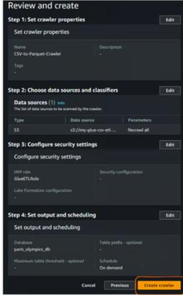
Finally, review everything and click “Create crawler.”

Slide 68
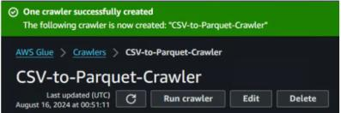
After the previous action of creating a crawler, we should see the following result confirming its creation:

Slide 69
5. Running a Glue crawler
Select your crawler from the list.
Click "Run crawler."
Wait for the crawler to finish. This may take a few minutes.
Once complete, go to "Databases" under "Data catalog" in the left sidebar.
Click on the database that was created.
You should see a table that represents your CSV data structure.

Slide 70
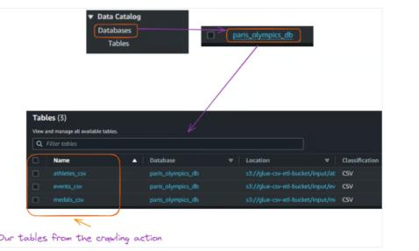

Slide 71
6. Creating and running a Glue job
With our data catalog created, we can now create a Glue job to combine our CSV files and convert them to Parquet format. This section walks you through creating the Glue job and provides the necessary Python code.
Go to "Jobs" under "ETL" in the AWS Glue console in the left sidebar.
Select the Script editor to open an editor to write a Python code, and click “Create script.”

Slide 72
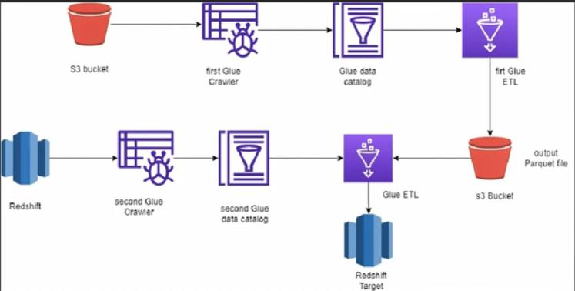

Slide 73
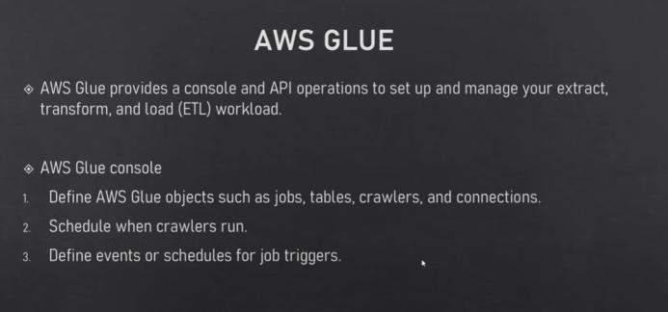

Slide 74
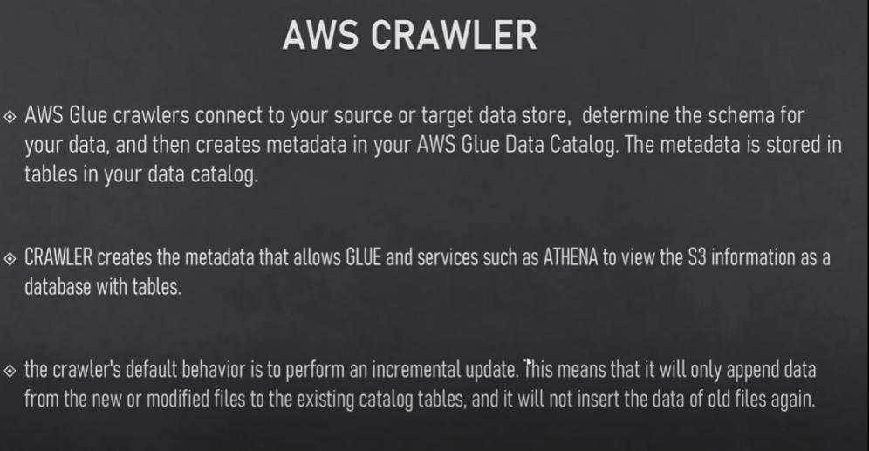

Slide 75
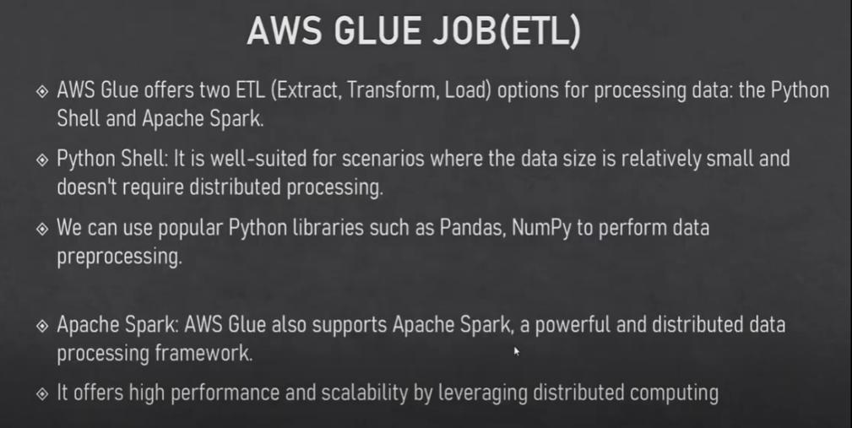

Slide 76
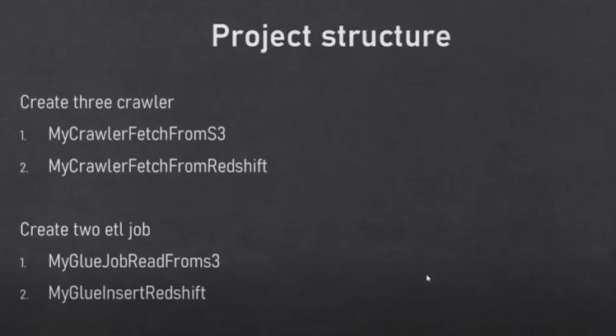

Slide 77
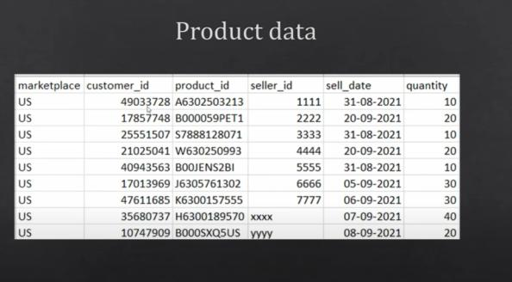

Slide 78
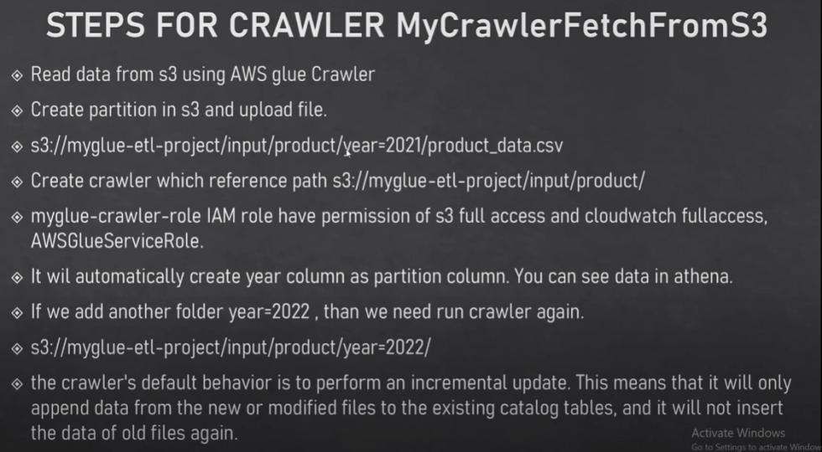

Slide 79
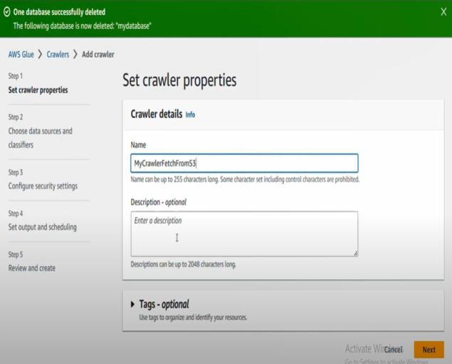

Slide 80


Slide 81


Slide 82


Slide 83


Slide 84


Slide 85


Slide 86


Slide 87


Slide 88


Slide 89


Slide 90


Slide 91


Slide 92


Slide 93


Slide 94


Slide 95


Slide 96


Slide 97


Slide 98


Slide 99


Slide 100


Slide 101


Slide 102


Slide 103


Slide 104


Slide 105


Slide 106


Slide 107


Slide 108


Slide 109


Slide 110


Slide 111


Slide 112


Slide 113


Slide 114


Slide 115


Slide 116


Slide 117


Slide 118


Slide 119


Slide 120


Slide 121


Slide 122


Slide 123


Slide 124


Slide 125


Slide 126


Slide 127


Slide 128


Slide 129


Slide 130


Slide 131


Slide 132


Slide 133


Slide 134


Slide 135


Slide 136



Slide 137


Slide 138


Slide 139


Slide 140


Slide 141


Slide 142


Slide 143



Slide 144




Slide 145


Slide 146



Slide 147


Slide 148




Slide 149


Slide 150


Slide 151



Slide 152


Slide 153


Slide 154


Slide 155


Slide 156


Slide 157


Slide 158


Slide 159


Slide 160


Slide 161


Slide 162


Slide 163



Slide 164


Slide 165




Slide 166


Slide 167



Slide 168


Slide 169

Schedule DS job

Slide 170



Slide 171



Slide 172



Slide 173



Slide 174



Slide 175



Slide 176


Slide 177



Slide 178


Slide 179





Slide 180



Slide 181




